Slide 1
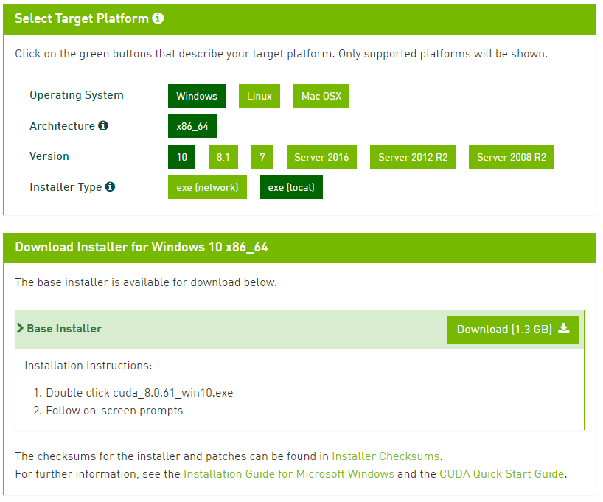
Prerequisites 1 – Download and Install CUDA
https://developer.nvidia.com/cuda-downloads

Slide 2
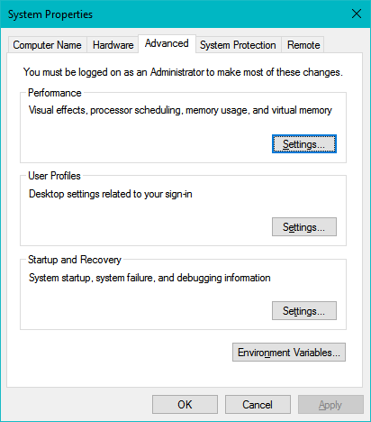
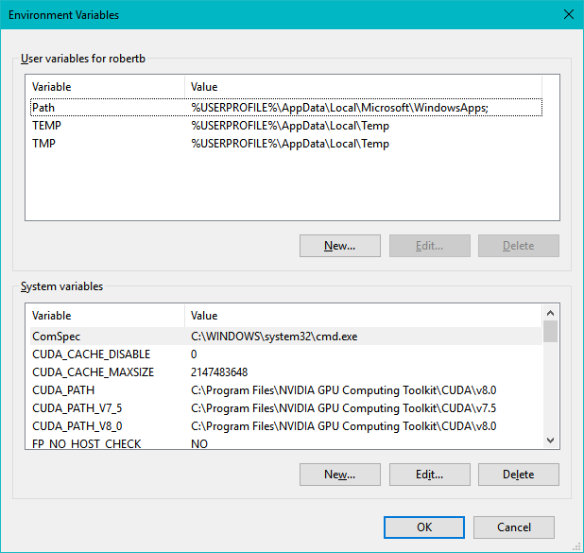
Prerequisites 2 – Modify System Variables
After CUDA is installed, add (or modify) the following two system variables (and sign off then sign back in or restart the PC to apply the changes) in Control Panel→ System and Security→ System→ Advanced system settings→ Environment Variables to the following values:
CUDA_CACHE_DISABLE set to 0
CUDA_CACHE_MAXSIZE set to 2147483648

Slide 3
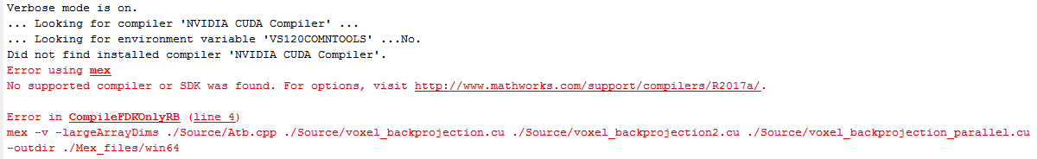
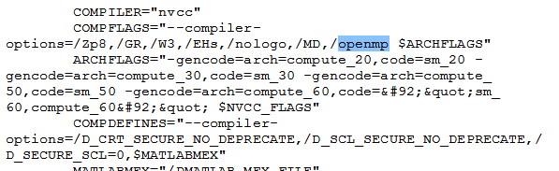
Changes Needed to Compile with OpenMP
On my Win 10 system with Matlab R2017a, Parallel Processing Toolbox, MS Visual Studio 2015, and CUDA 8.0.61 I had to make the following changes to build the code with OpenMP (or to build it at all):
Change “mex” to “mexcuda” in Compile.m. “Mex” used to work fine with previous versions of MATLAB (and CUDA), but with R2017a the error message is:
Add /openmp compiler flag to MEX options file: C:\Program Files\MATLAB\R2017a\toolbox\distcomp\gpu\extern\src\mex\win64\nvcc_msvcpp2015.xml
Add
Changes needed to use multiple GPUs in parallel
(The modified MEX code will build fine without the /openmp flag, but all the OpenMP pragmas will be simply ignored and the code will be executed sequentially, i.e. multiple GPUs will NOT be used in parallel!)

Slide 4
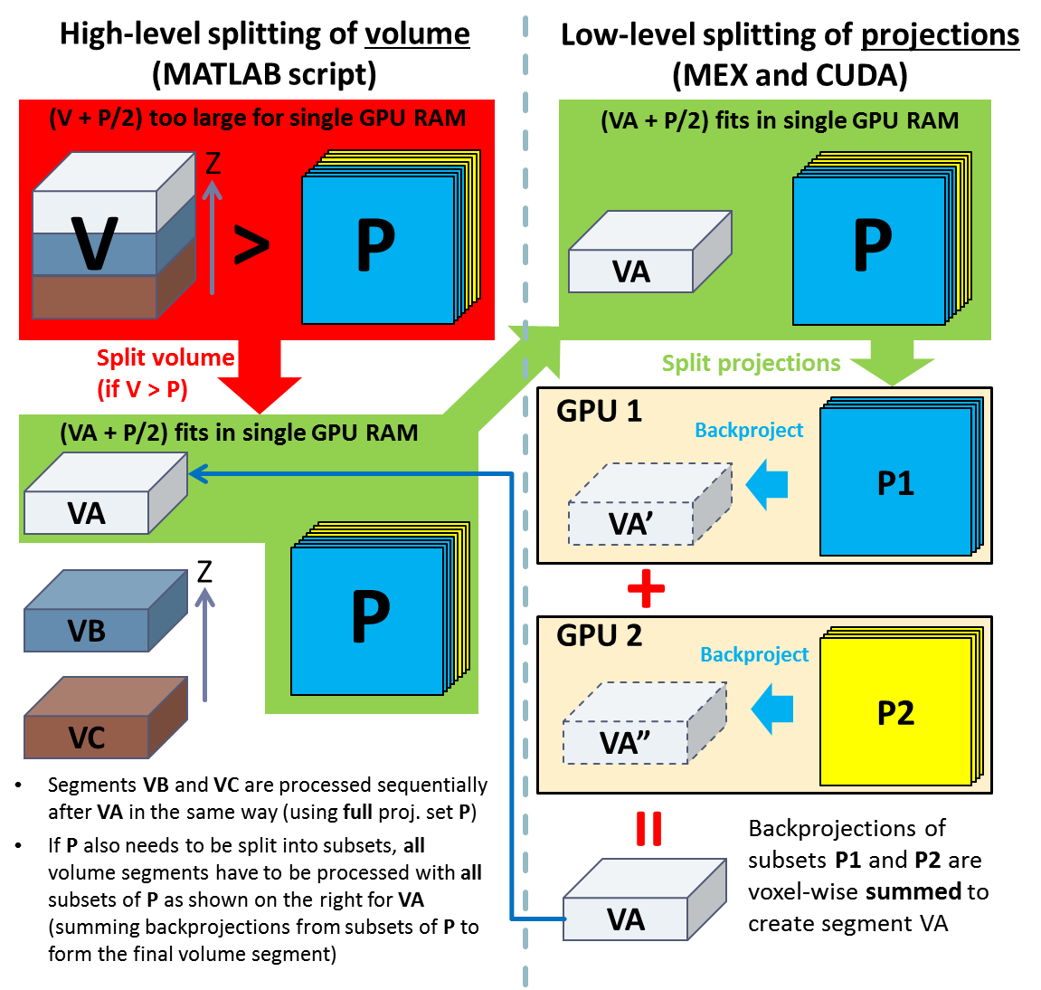
Implemented Large Data and Multi-GPU Processing
Figure shows an example of data processing for FDK backprojection, with 2 GPUs present
High-level data splitting is implemented in FDKLargeData.m (figure shows high-level splitting of only volume (V) data, but projection (P) data will be split as well or instead if necessary)
Further low-level projection data (only) splitting between multiple GPUs is implemented in Atb.cpp and voxel_backprojection.cu/hpp
Handling large data is simpler in forward projection:
AxLargeData.m performs high-level splitting of volume data only, if needed
Since in the CUDA code only a single projection is loaded to a GPU at a time to be processed, no high-level projection dataset splitting is ever needed (unlike in backprojection),
The low-level code (implemented in Ax.cpp and ray_interpolated_projection.cu/hpp) simply splits the projection set between the GPUs, and the GPUs process their subsets in parallel (each GPU works projection-by-projection in its subset of projections)

Slide 5
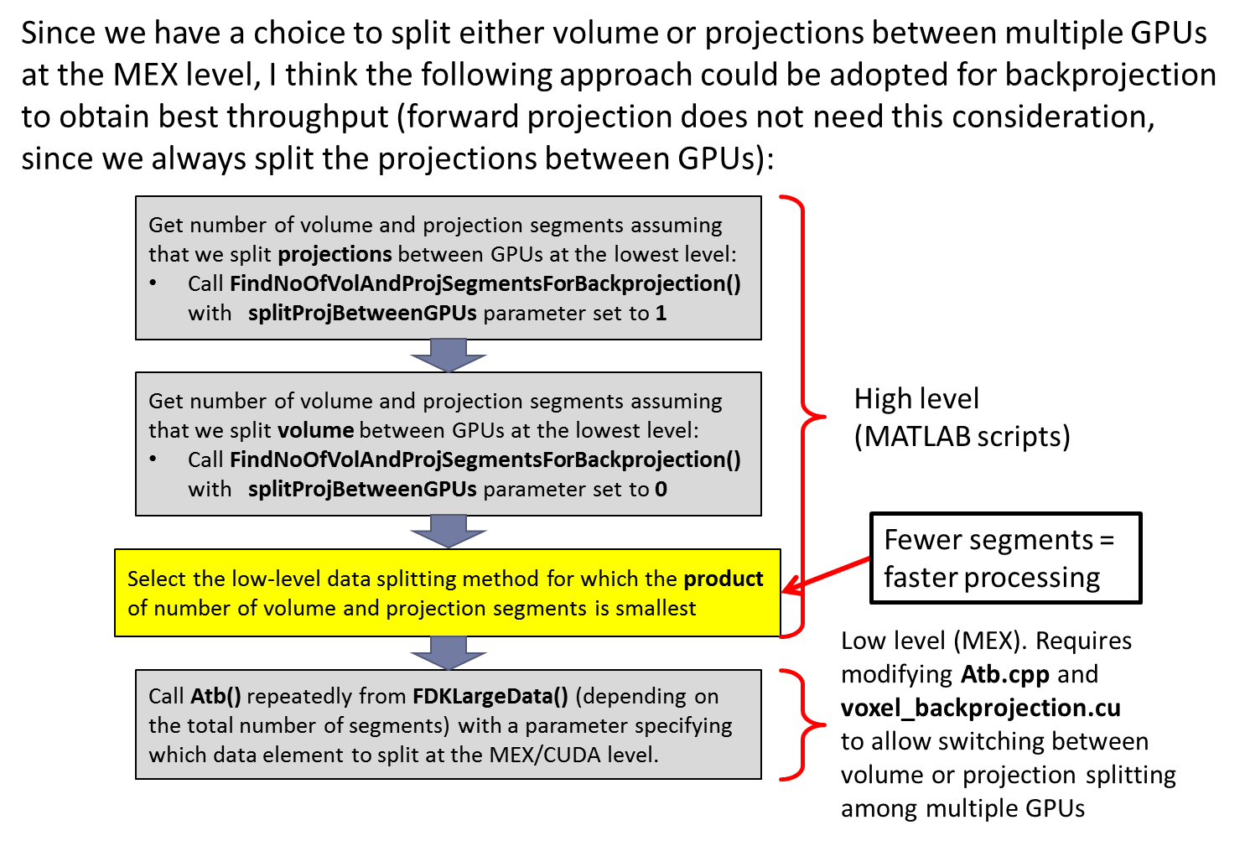
Possible More Advanced Large Data Handling for Backprojection (NOT Implemented so Far)
This is an idea that could result in more optimized data splits (=faster processing) in some cases, but the benefits may not be very significant and may not be worth further complicating the high- and low-level backprojection code
The current multi-GPU code always splits projections between multiple GPUs at the low (MEX) level in backprojection

